Slide 1

Welcome to Bellam Chai
Discover Bellam Chai: A Sweet Franchise Opportunity
Welcome to Bellam Chai. We are a Hyderabad-based tea brand. Our unique blend uses jaggery instead of sugar. This offers a healthier and delicious experience. We combine great taste with traditional wellness.

Slide 2

Our Prime Locations & Commitment to Quality
High-Footfall Areas
Our outlets are strategically located in busy areas. This ensures maximum visibility and customer traffic.
Quality & Hygiene
We uphold the highest standards. Our outlets maintain impeccable quality and hygiene.
Flagship Outlet
Visit our flagship outlet in Kondapur, Hyderabad. Experience our brand firsthand.
Hyderabad Opportunities
Currently, company-owned franchise opportunities are exclusive to Telangana and Andhra pradesh

Slide 3



The Founder's Vision: Wellness Through Tradition
Meet Our Proprietors
PESALA HEMANTH KUMAR REDDY founder
PESALA BHARATH REDDY co founder
of Bellam Chai
Our founder’s envisioned promoting traditional wellness. This vision is deeply embedded in Bellam Chai. We offer a low-cost franchise model. This makes entrepreneurship accessible. It allows more people to share our healthy tea. Join us in this mission.
PESALA HEMANTH KUMAR REDDY
PESALA BHARATH REDDY
PESALA TEJESWAR REDDY Managing director
of Bellam Chai

Slide 4
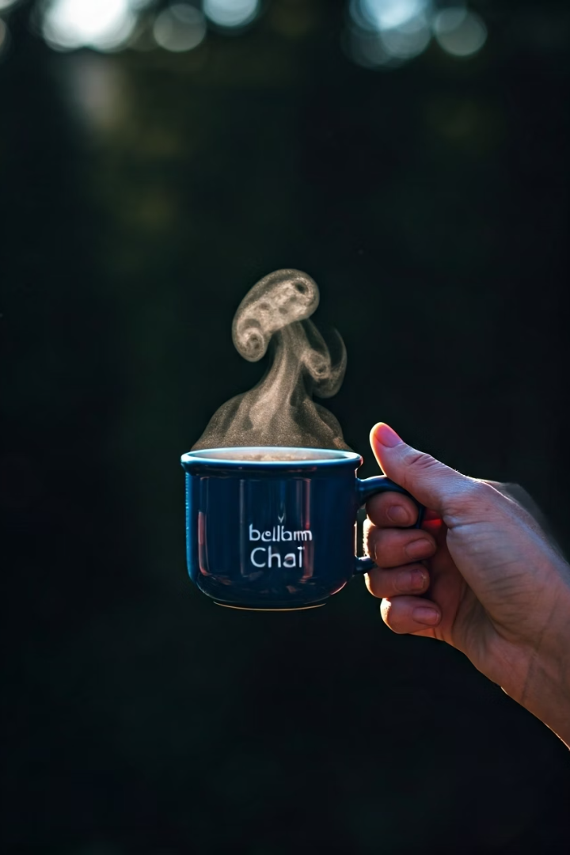




The Health Benefits of Bellam Chai
Boosts Immunity
Aids Digestion
Rich in Iron
Our tea helps activate digestive enzymes. This promotes better gut health.
Jaggery is a good source of iron. It helps prevent anemia.
Jaggery naturally enhances your body's defenses. It helps you stay healthy.
Regulates Blood Pressure
The potassium in jaggery assists in maintaining healthy blood pressure levels.

Slide 5





Our Franchise Model: Support & No Royalties
No-Royalty Model
We offer a 0% royalty franchise. Maximize your profits.
Kitchen Setup
Receive a complete kitchen setup. Get ready to operate quickly.
Full Branding
Benefit from our established brand. Get ready-to-use branding materials.
Comprehensive Training
Expert training ensures you master our processes. Learn tea preparation and service.
Raw Materials Included
We provide essential raw materials. Start your business immediately.

Slide 6
Franchise Options: Type One & Type Two (₹1,25,000)
Type One
Type Two
Tea Menu Board
Box with Lockers
Tea Flasks (3L + 1.5L)
Kitchen Material
Deep Freezer
Initial Raw Materials
Induction Stove
3-Day Training
Initial Raw Materials
3-Day Training

Slide 7
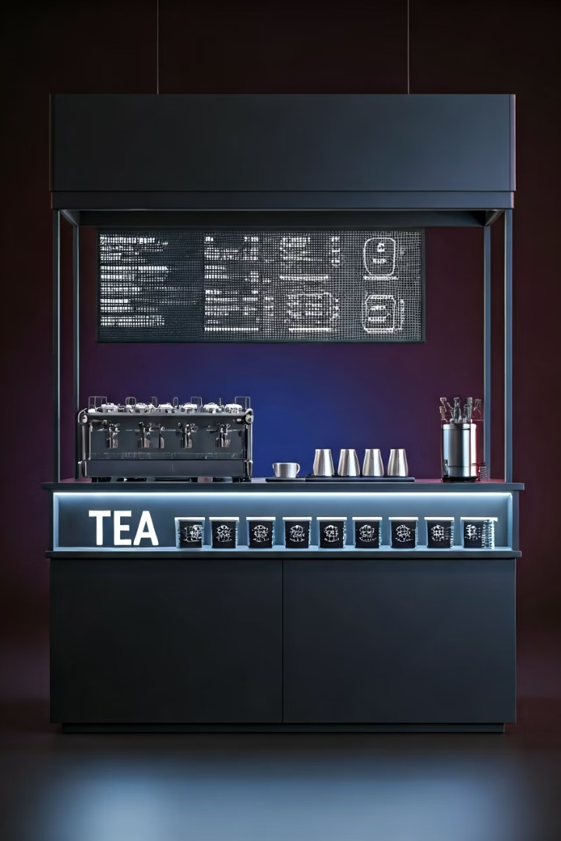
Franchise Option: Premium Setup (₹1,95,000)
Enhanced Visibility
Includes an attractive LED Board and full Tea Menu for display.
Expanded Equipment
Comes with Tea Flasks, Deep Freezer, and a Juicer for diverse offerings.
Operational Essentials
Provides an Induction Stove and all necessary Kitchen Materials.
Extended Training & Support
One-week comprehensive training and dedicated branding support are included.

Slide 8
Franchise Option: Full Setup (₹3,00,000)
All essential equipment for comprehensive operations.
Specialized tea tools for perfect brewing.
Complete branding kit for consistent visual identity.
Extensive training program ensures operational excellence.
Includes an 8x8 shutter for security and accessibility.
Essential items like dustbins, aprons, and trays are provided.
Lighters and a juice jar for complete service.

Slide 9
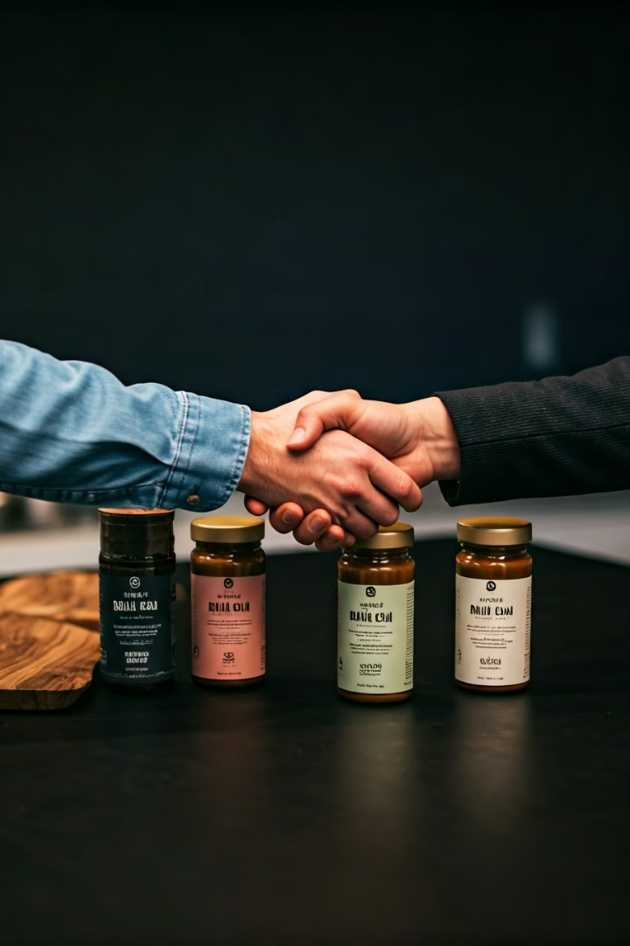
Thank You for Your Interest!
Explore more about Bellam Chai and our franchise opportunities. Visit our website or contact us directly. We look forward to partnering with you.
Website: www.BellamChai.in
Contact Number: 7597592888

